Slide 1


BDCC Workshop
Typical day of a big data engineer
March 2018
by Dmitrii Kober

Slide 2

AGENDA
1
BigData Overview
2
Problem Context
3
Case Study

Slide 3
BIG DATA Overview

Slide 4
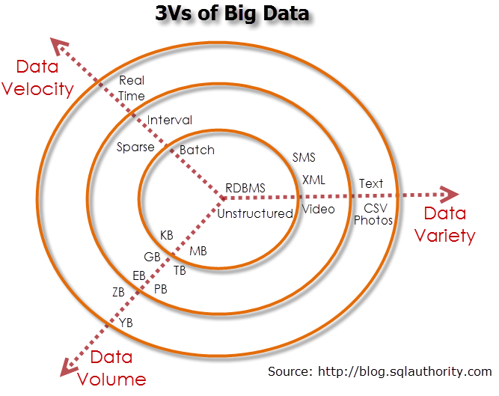
{Prerequisites #1

Slide 5
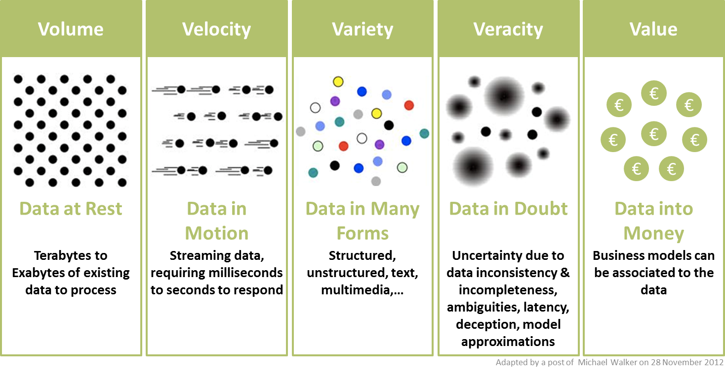
{Prerequisites #2

Slide 6
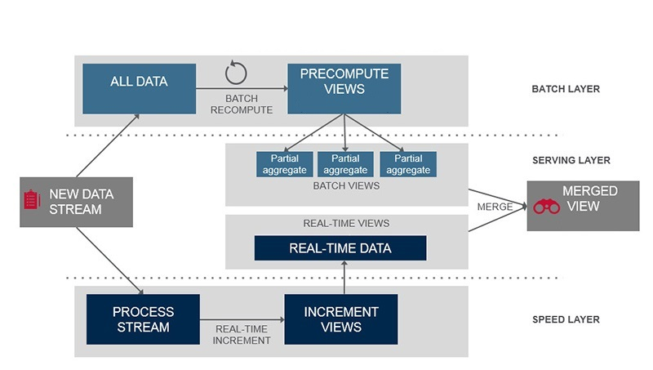
{Big Data approach: Lambda Architecture

Slide 7
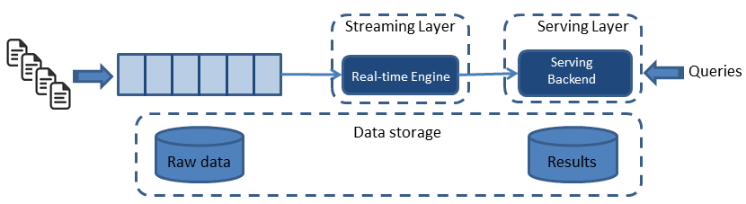
{Big Data approach: KAPPA Architecture

Slide 8
Case study

Slide 9
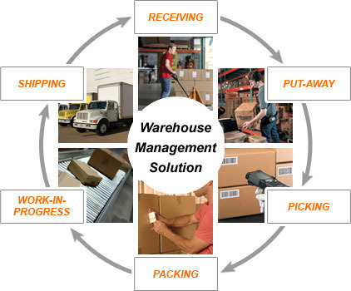
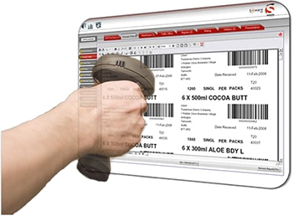
Warehouse management service

Slide 10
{Problem Context
!
!
BUSINESS ITEMS TO CONSIDER
TECHNICAL ITEMS TO CONSIDER
The Application shall support a large number of organizations, each with its own members, business partners, customizations, preferences and application usage specifics.
All data updates have to pass review/approve lifecycles before being actually applied.
The problem of calculating fair commissions to be charged from tenants, based on their shares in the system utilization.
The solution has to be cloud-ready, cost and resource effective, highly-available (99.9%), fault-tolerant, scalable, performant and ensuring tenant data isolation and protection.
The solution architecture has to be sustainable, well-integrated with the existing X-Customer enterprise architecture and comply with X-Customer policies and standards.
Not only human-beings, but also automated 3’rd party systems shall be using the platform.

Slide 11
Solution Overview

Slide 12
Solution Presentation: Overview
The solution is inspired by:

Slide 13
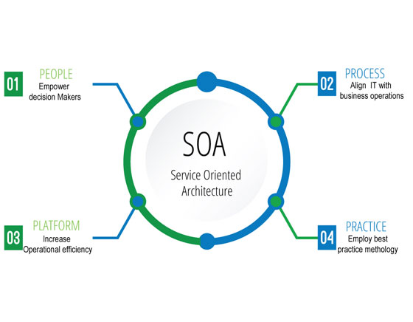
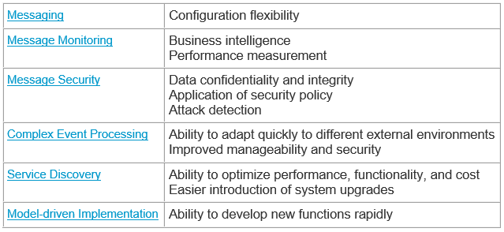
Solution Presentation: Overview
The solution is inspired by:
Profit:
SOA

Slide 14
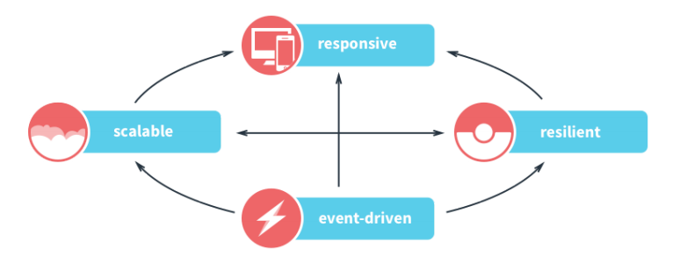
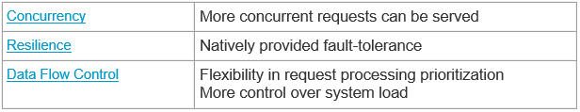
Solution Presentation: Overview
The solution is inspired by:
Profit:
SOA
Reactive Architecture

Slide 15

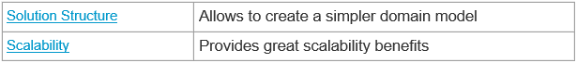
Solution Presentation: Overview
The solution is inspired by:
Profit:
SOA
Reactive Architecture
Decoupling Reads and Writes

Slide 16
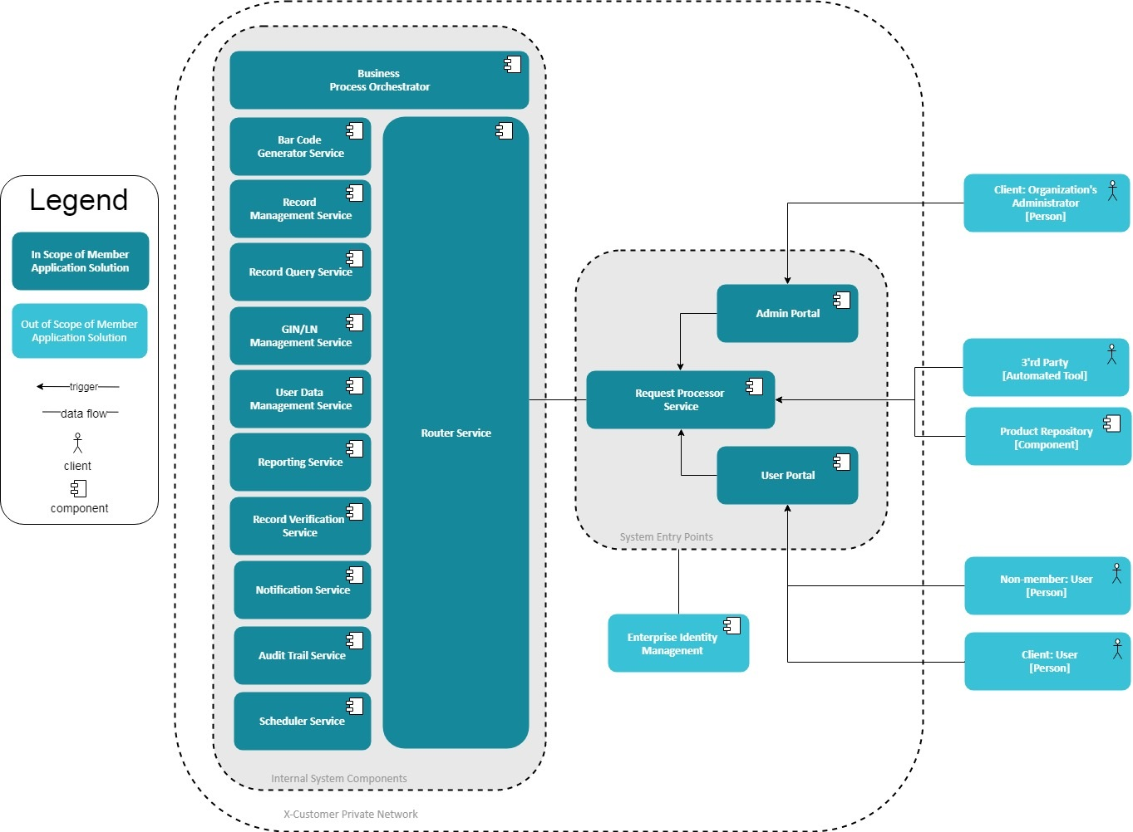
Solution Presentation: Overview
The solution is inspired by:
SOA
Reactive Architecture
Decoupling Reads and Writes

Slide 17

Solution Presentation: Rationale
BENEFITS
Scalability
High-availability
Security
Performance
Fault-tolerance
Flexibility

Slide 18
Narrowing down

Slide 19
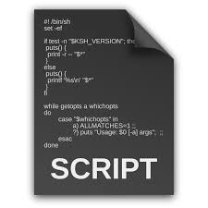
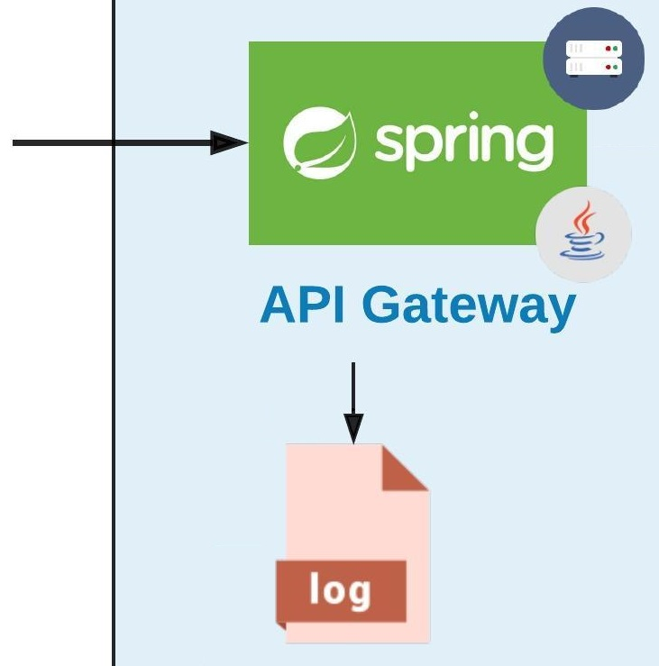
API gateway

Slide 20
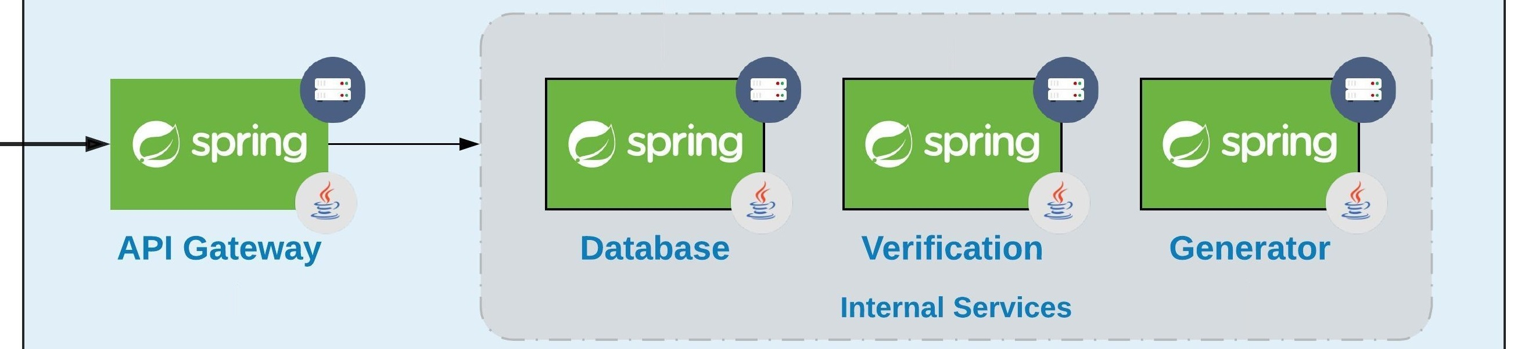
Let’s Introduce a couple of Services

Slide 21
how about communication? Are there any problems?

Slide 22
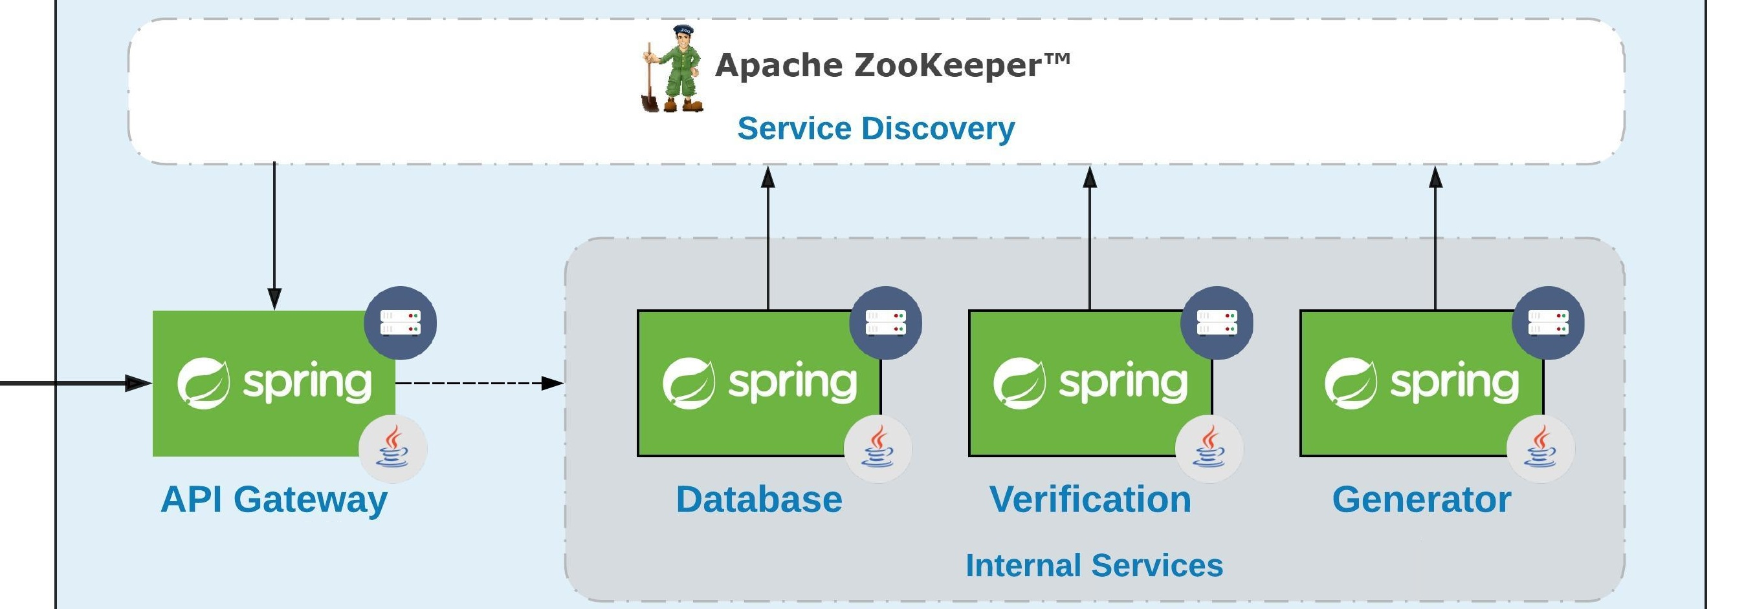
Service Discovery to the rescue!
!

Slide 23
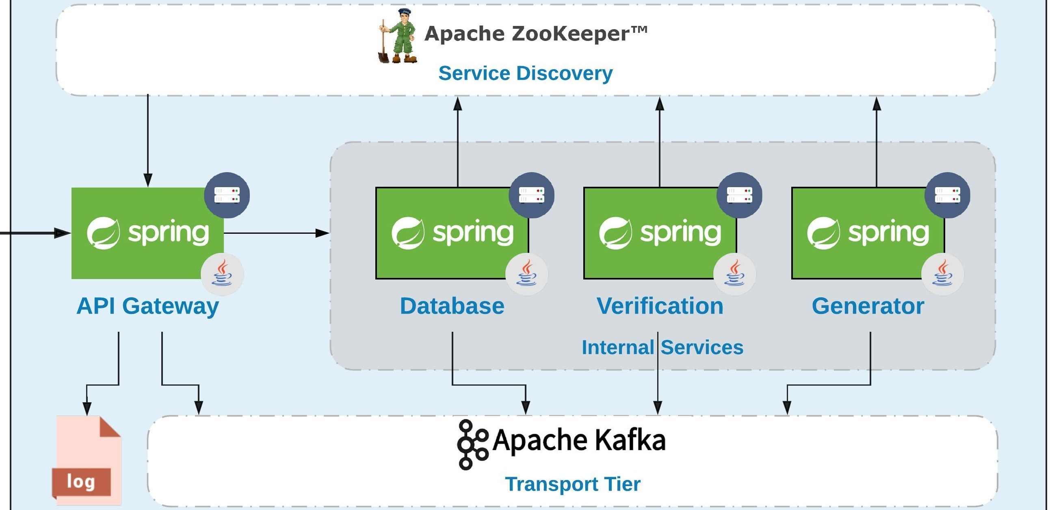
So we have ‘reactive soa’. What about Messaging?

Slide 24
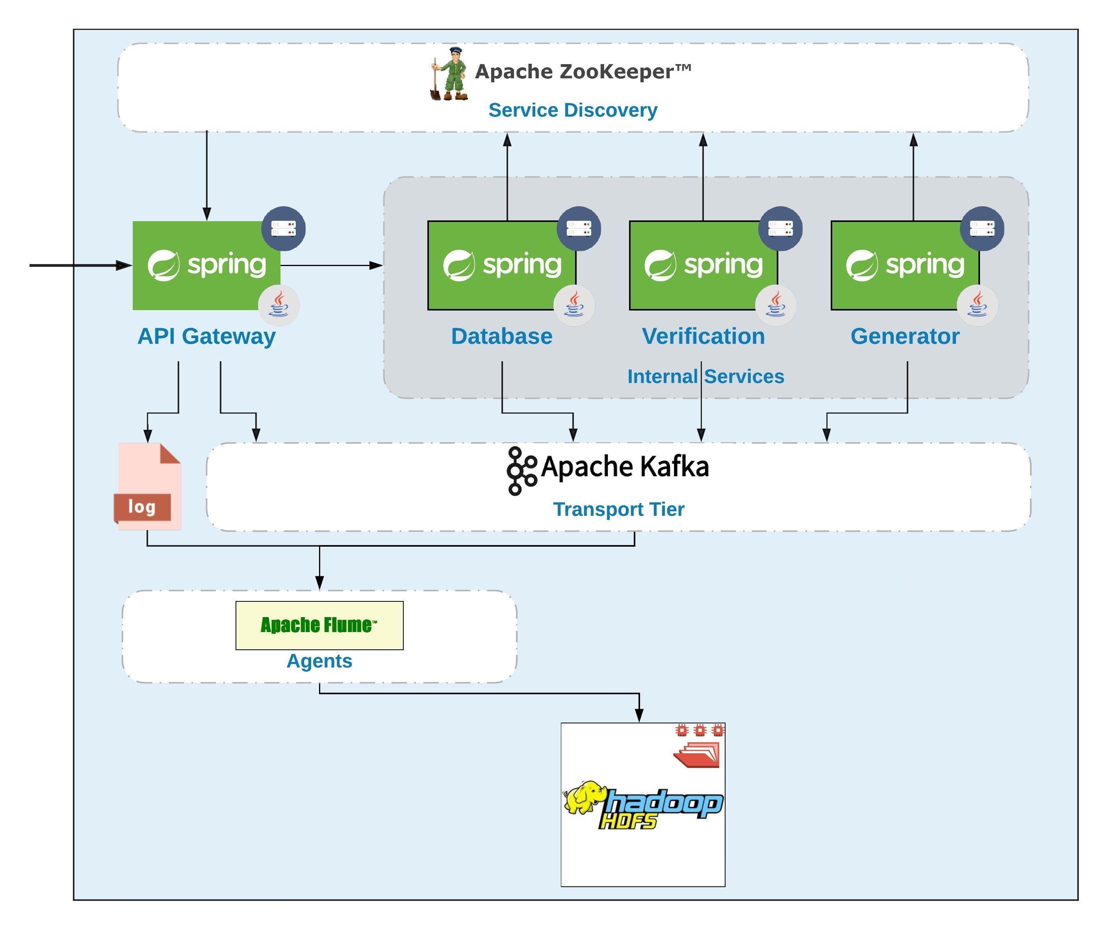
Now its time for batch layer

Slide 25
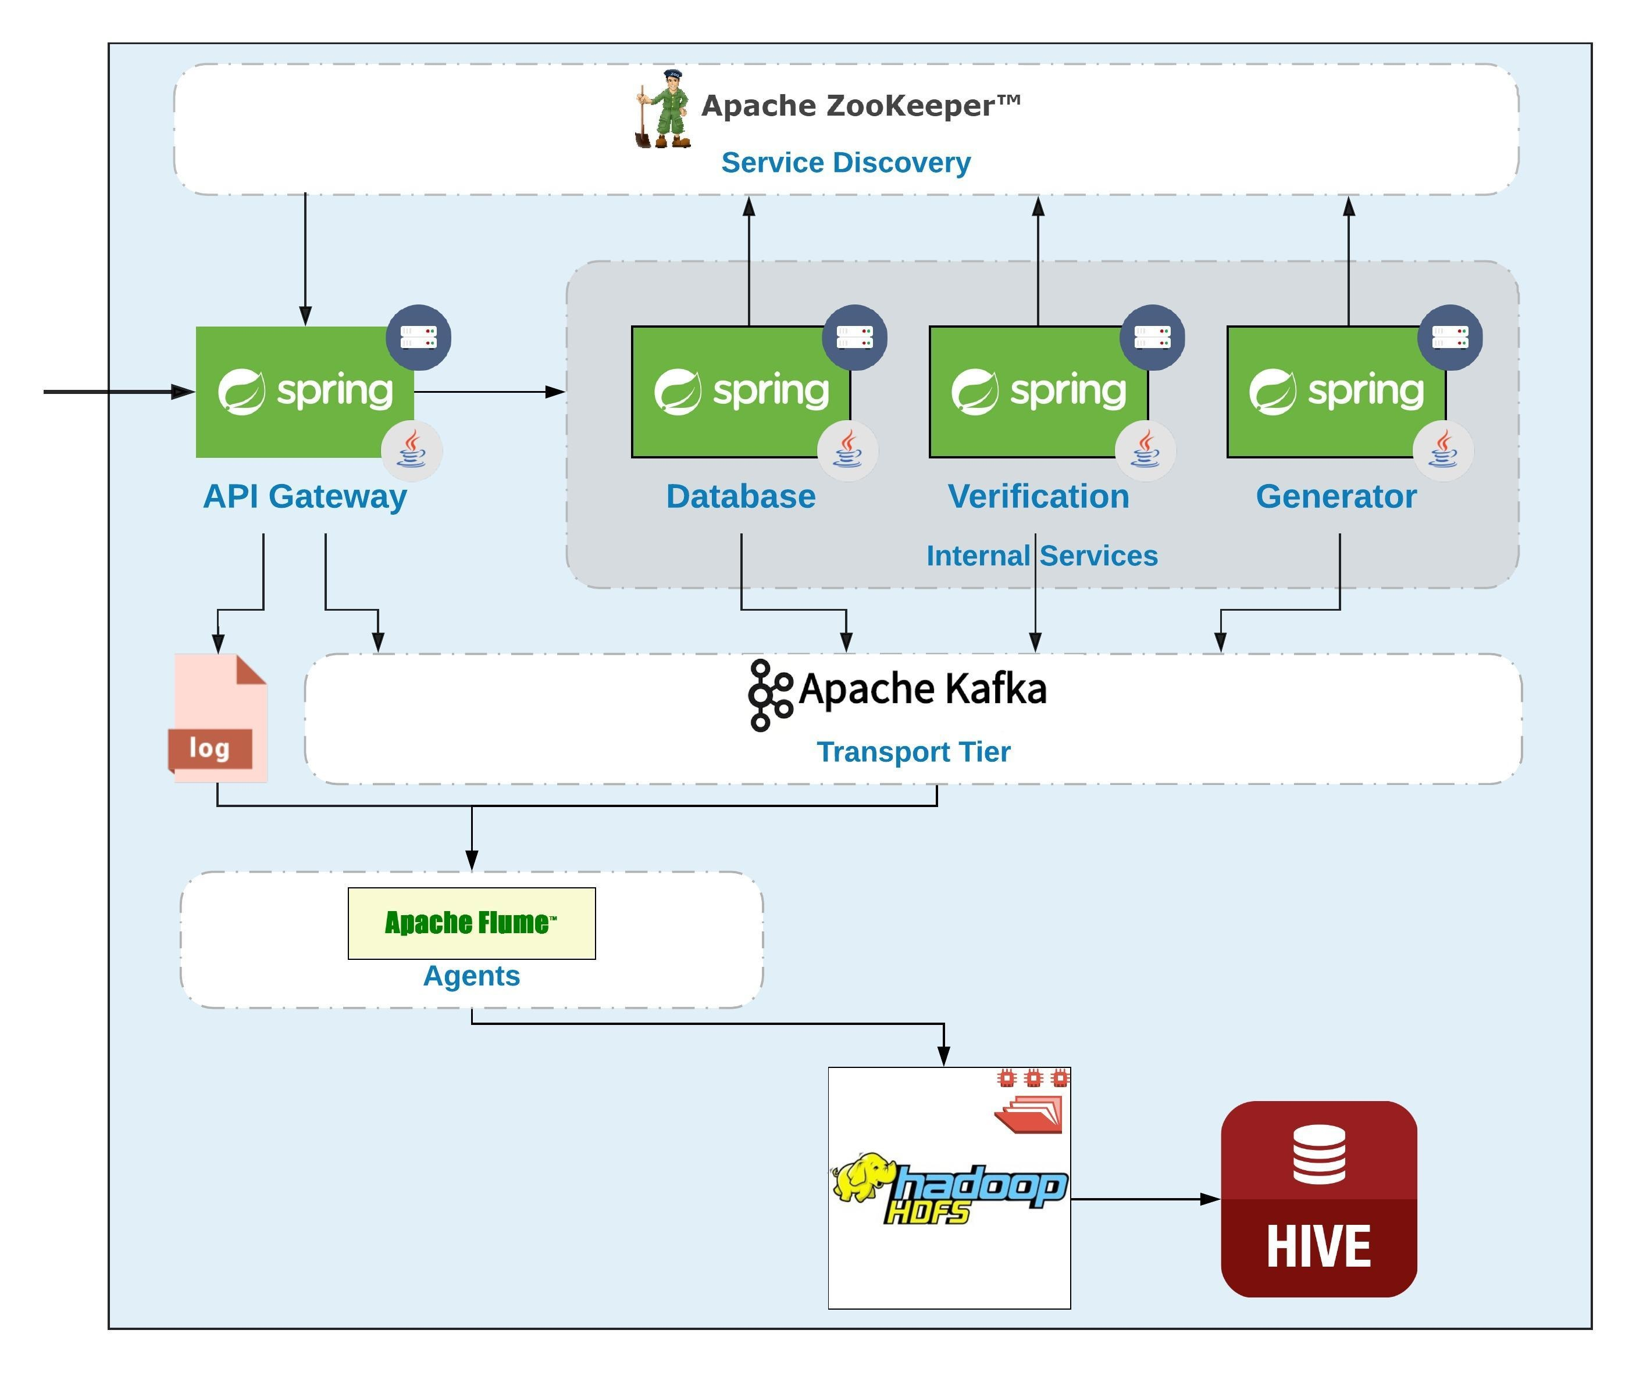
Let’s Add some Data analysis

Slide 26
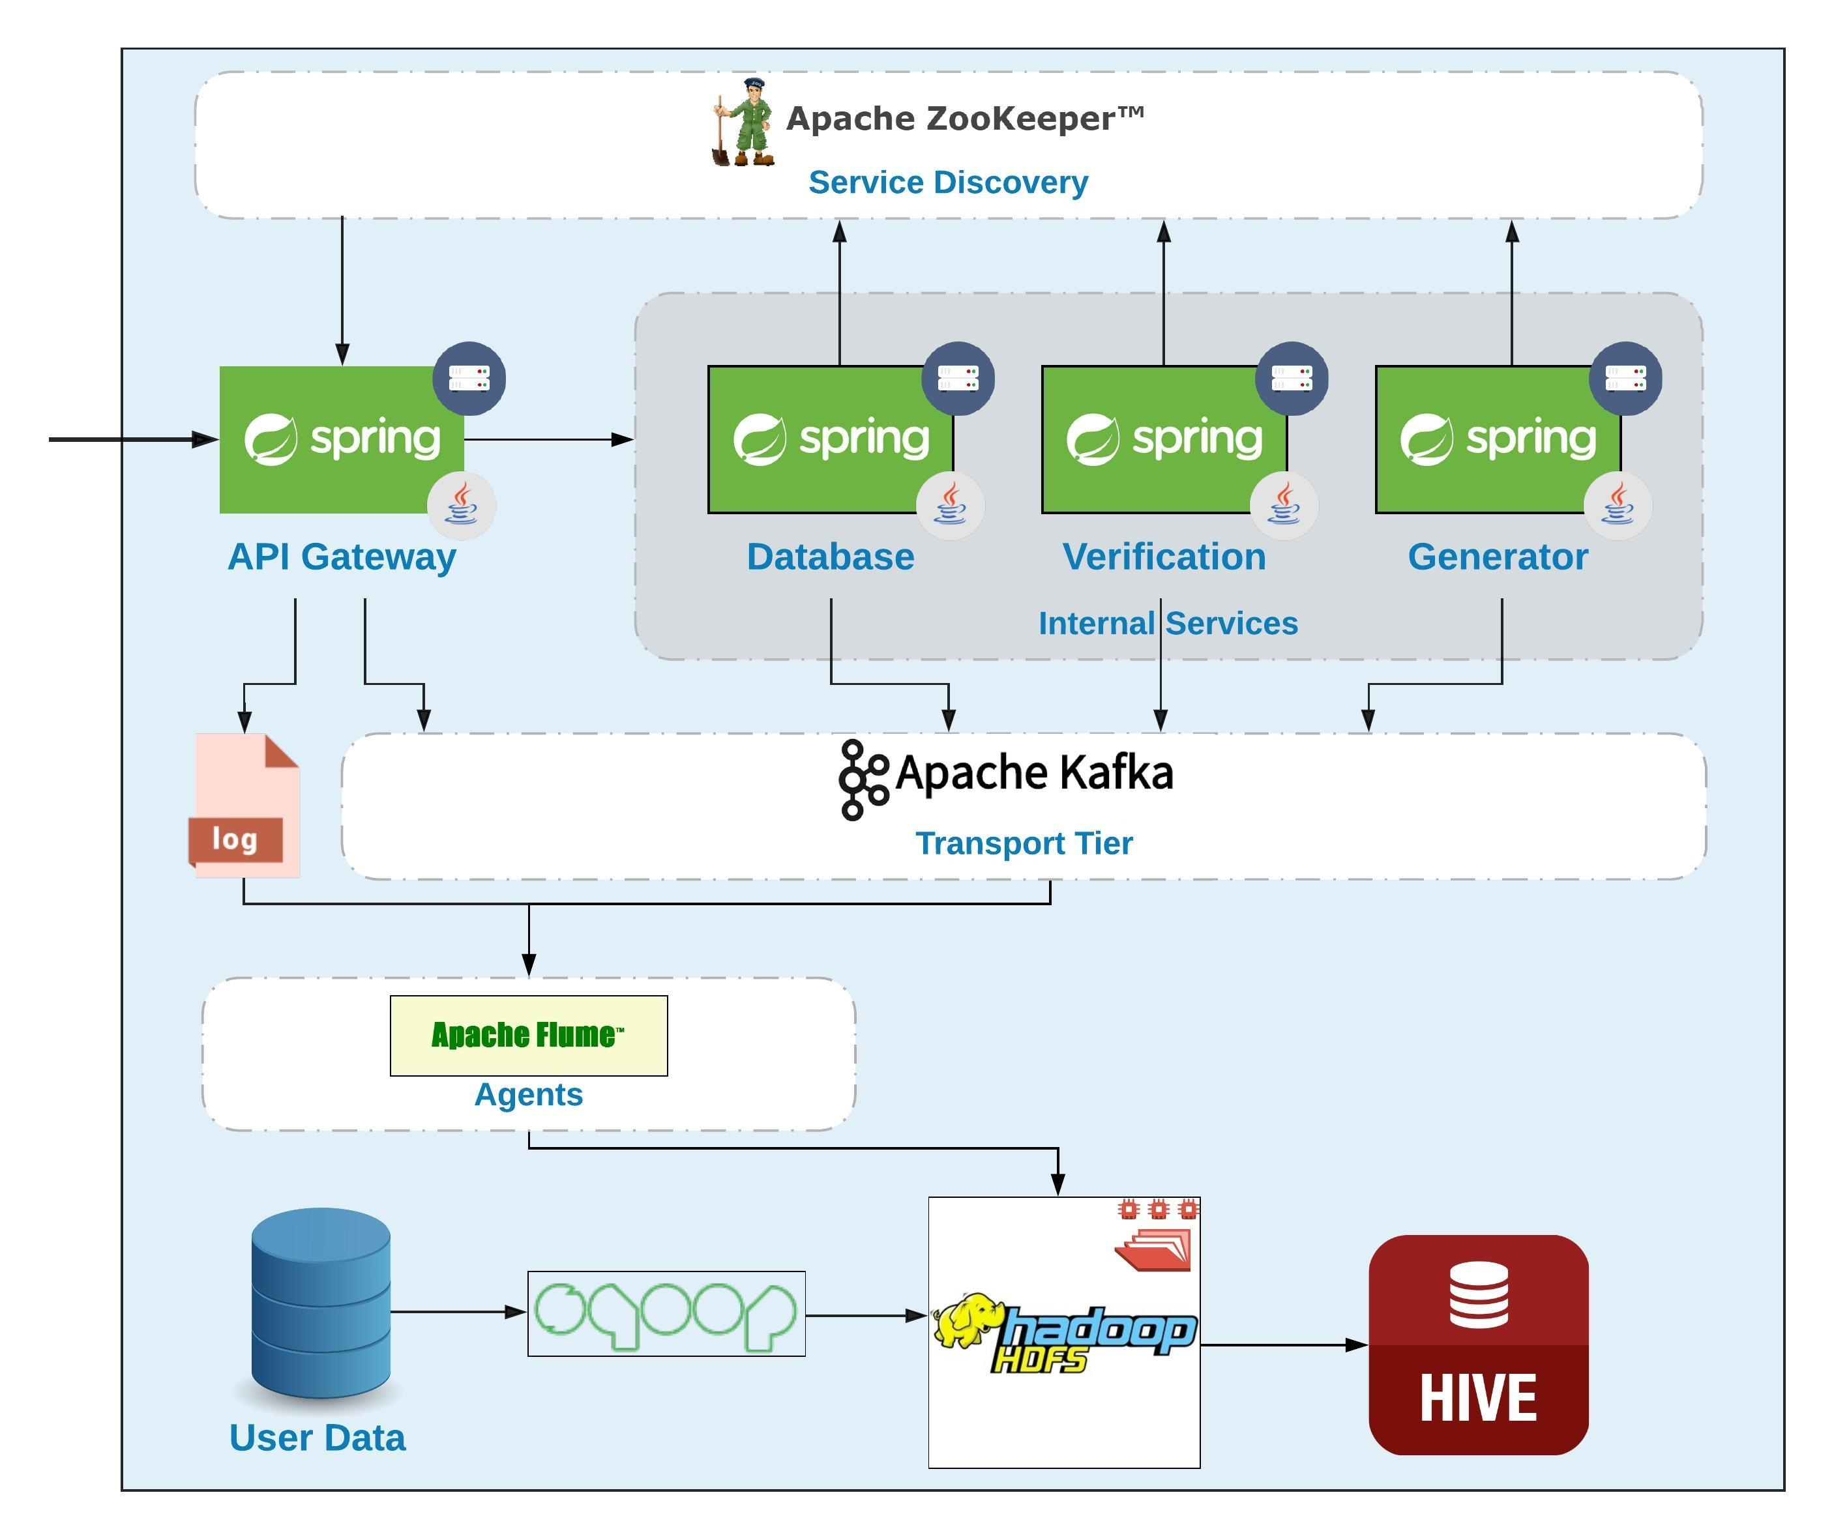
Here Variety Comes…

Slide 27
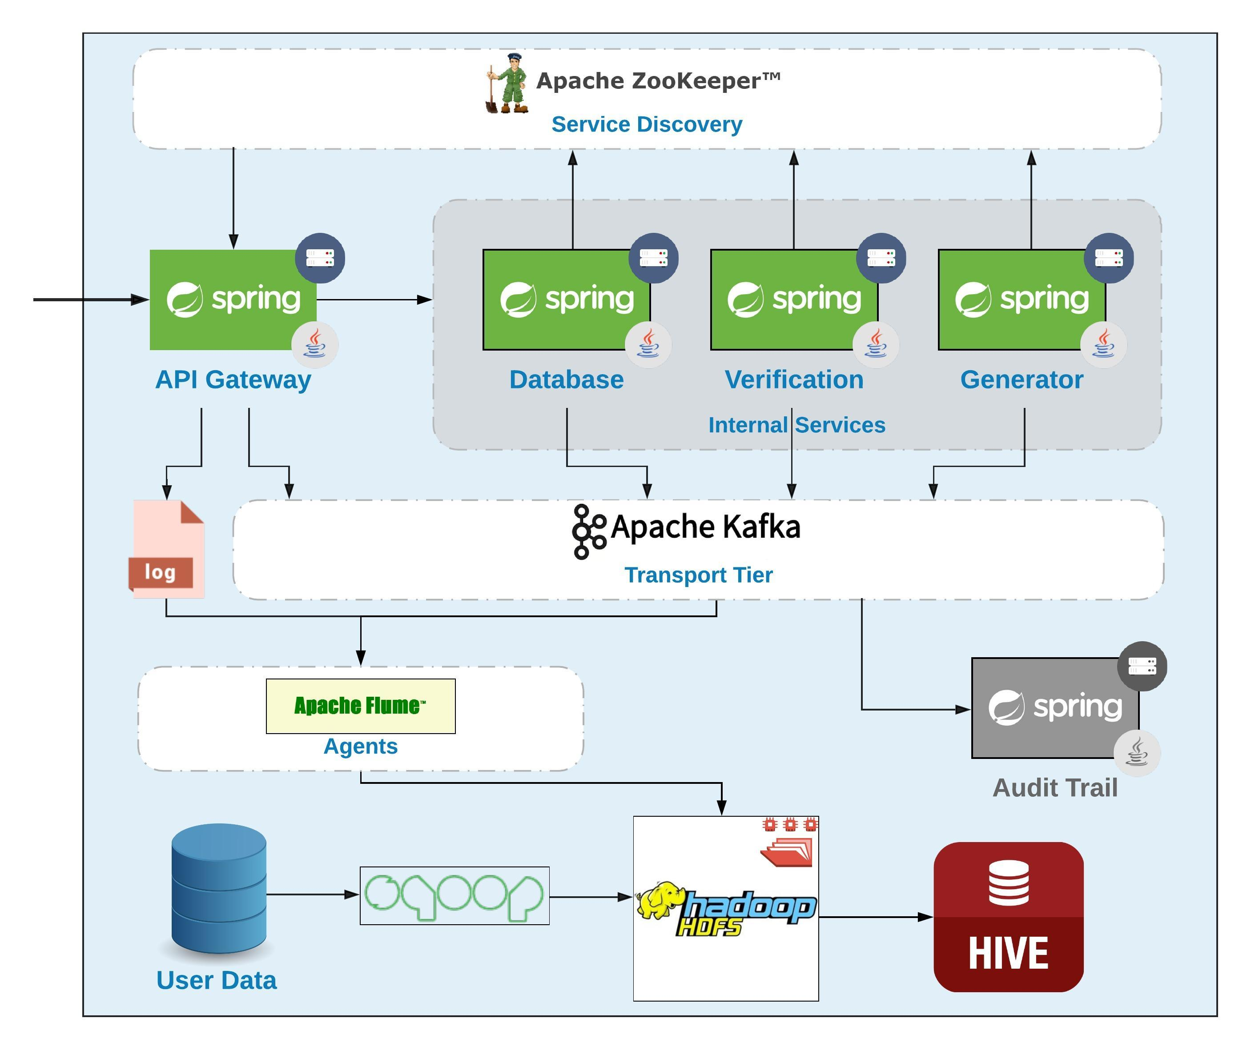
Realtime Layer? Your Turn ;)

Slide 28

Thank You!

